Slide 1
Module 2 – Multidimensional Array

Slide 2
Multi Dimensional Array
Multidimensional arrays are implemented as arrays of arrays.
Multidimensional arrays are useful when you want to store data in a tabular form, like a table with rows and columns.

Slide 3
To create a two-dimensional array, add each array within its own set of curly braces:

Slide 4

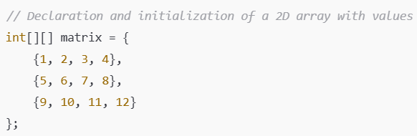

Slide 5

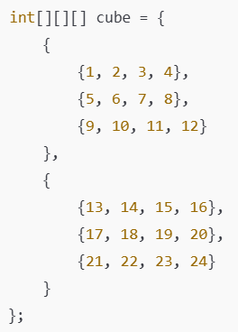
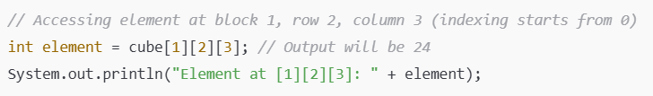

Slide 6

Accessing Elements
We have to specify 2 indexes.

Slide 7
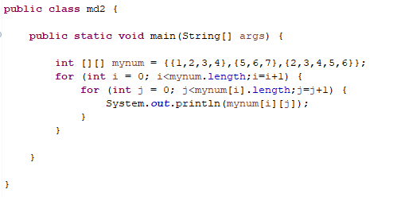
Accessing Elements using For Loop

Slide 8
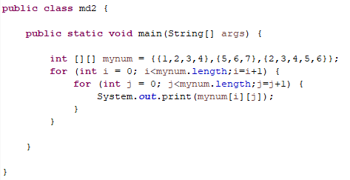
OUTPUT:

Slide 9
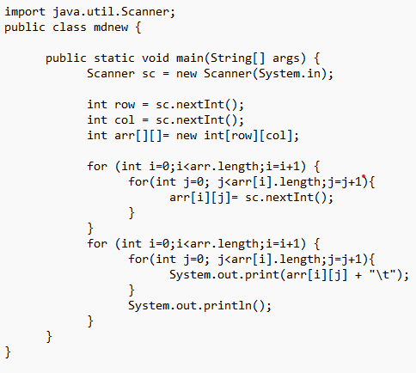
Multi Dimensional Array – ‘new’

Slide 10
TASK
Declare and create a two-dimensional array of strings named colors. Put the colors (“red”, “yellow”, “blue”) in the first row and the colors (“orange”, “green”, “purple”) in the second row. Then print every value in the array.
Write a java program to count and the number of 5’s present in the 2D array. int[][] array = { {5,5,8},{5,8,7},{5,5,5},{3,6,8,5} }

Slide 11
Declare an array of size ‘n’ and add elements in the array. Write a Java program to find a pair in the array that matches the given sum (user-defined).
Given an array of integers of size ‘n’, find and print all the leaders of the array. A leader is defined as an element of the array which is greater than all the elements following it.
Write a Java program to find total marks and percentage for ‘n’ number of subjects.

Slide 12
6. Write a Java program to find a pair in the array of size ‘n’ with the given difference (user-defined).
7. Write a Java program to move all zeroes to the end of an array.
8. Write a Java program remove all the duplicates present in an array.

Slide 13
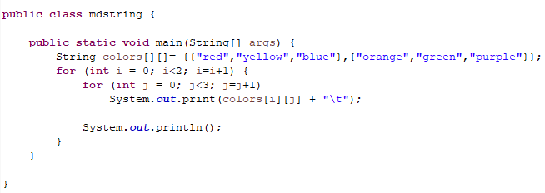
1

Slide 14
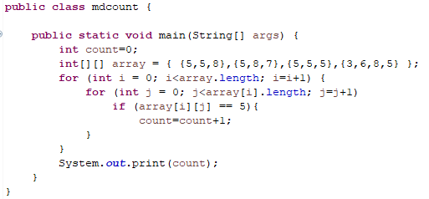
2

Slide 15
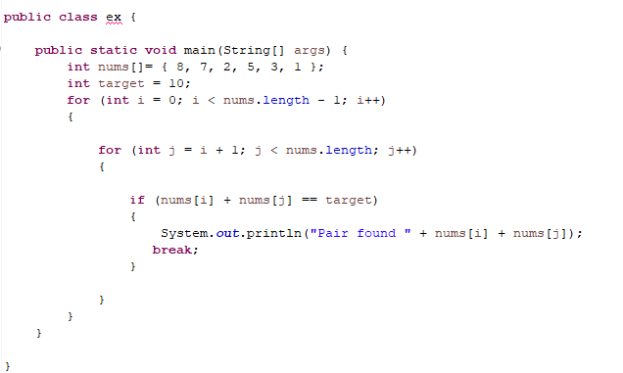
3

Slide 16
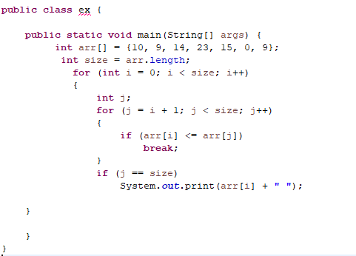

Slide 17
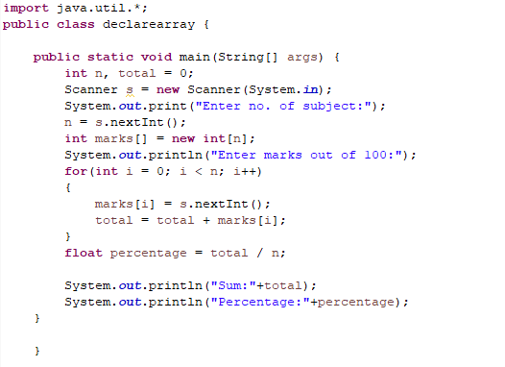

Slide 18
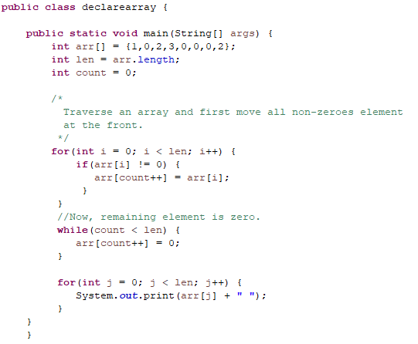

Slide 19
